Slide 1
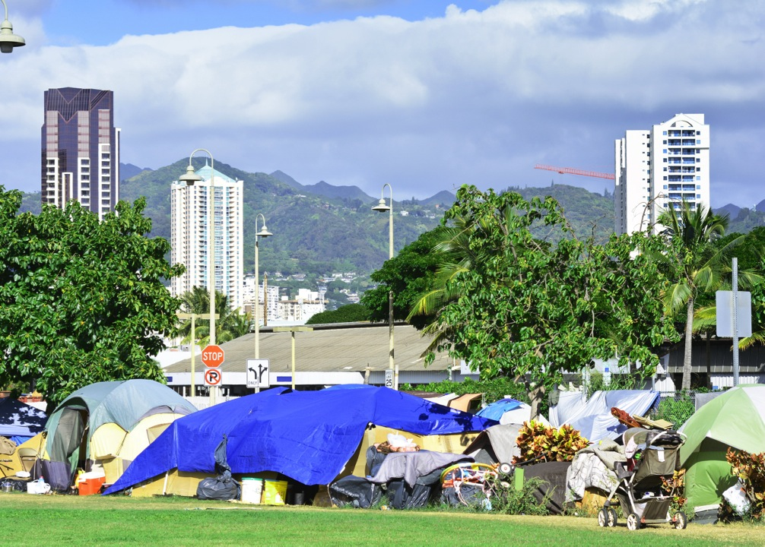
Mobile Outreach: Responding to Homelessness through an Open & Closed Source Community Referral App

Slide 2

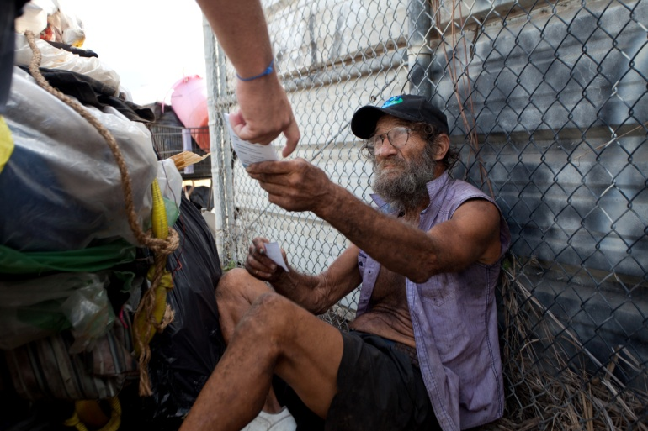
THE CHALLENGE
HELP Homeless Outreach Teams Efficiently Respond to Community Referrals Through Use of Mobile Apps

Slide 3
WHY IS A MOBILE OUTREACH TOOL IMPORTANT AND NEEDED TO ADDRESS HOMELESSNESS IN HAWAII?

Slide 4

#1 There is a demand for a mobile community referral system
FY16 Community Referral Statistics – IHS received at least 3,175 homeless referrals from concerned community stakeholders:
955 via IHS’ Website
845 via Businesses (Ex: Security Guards, Hotels, Condos, Parking Lots, etc.)
639 via Hospitals and Medical Centers
587 via Email & Social Media
149 via Phone (including AUW 211 & Partners)
NO MOBILE TOOLS AVAILABLE IN HAWAII
Notes:
IHS has received more referrals from our community this past fiscal year than any year prior.
THERE IS A HIGH DEMAND, but no mobile tools available to allow
Inbound information allows IHS and homeless providers to better understand where homeless people are, and how to respond.
A mobile app also becomes a more centralized source to refer homeless clients

Slide 5

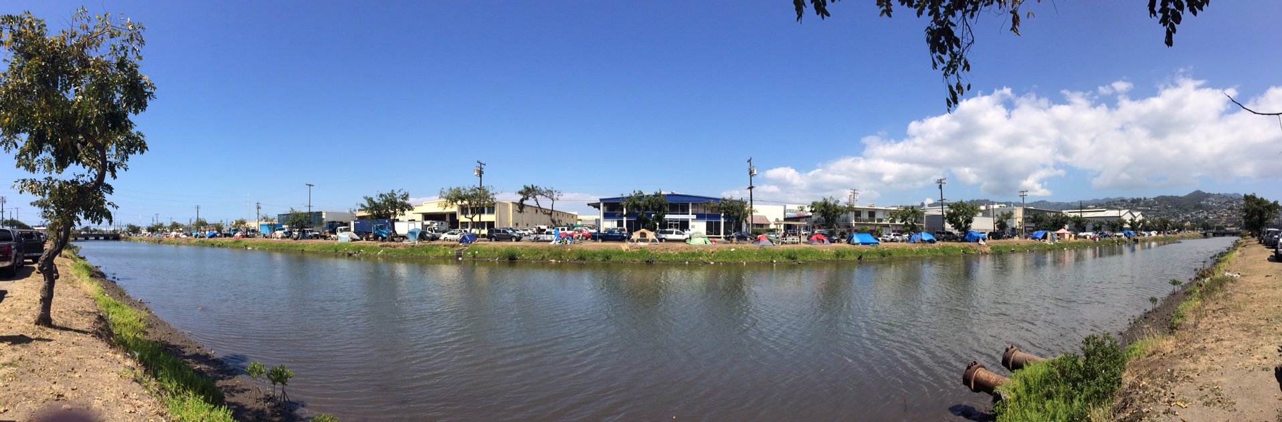

#2 - Homeless Migration – Kapalama Canal Case Study
Daytime Assessment 6:30AM – 9:00PM
40% COFA Migrants
10-13 families
60% Locals
40% Singles & Couples, Substance Abuse Users
20% Local Families
Response Strategies Based on Inter-Relationship of Systems & Information
Notes:
Homeless are mobile. Many DO NOT have smart phones or a lot of cell minutes. This makes it difficult to find our clients when looking. At the same time, while IHS and other providers move thousands of people out of homelessness each year, more continue to fall in we do not know of.
Regardless, homeless populations change regularly, as regular as day/night hours.

Slide 6
#2 - Homeless Migration – Kapalama Canal Case Study
Nighttime Assessment 9:00PM – 6:30AM
70% COFA Migrants
15-20 families, most have cars
30% Locals
Local residents (Filipinos and Hawaiians)
Diverse age group (early 20’s – early 60’s)
Response Strategies Based on Inter-Relationship of Systems & Information
Notes:
In FY14, IHS received more community referrals for Kapalama Canal than any other year. But while we were moving people off the streets, the weekly counts we conducted showed similar or more people living on the canal.
Goal is to create a by-name list of each individuals and to ensure they are in our systems, connected to services, and being case managed so that providers can remove barriers preventing them from accessing housing.

Slide 7
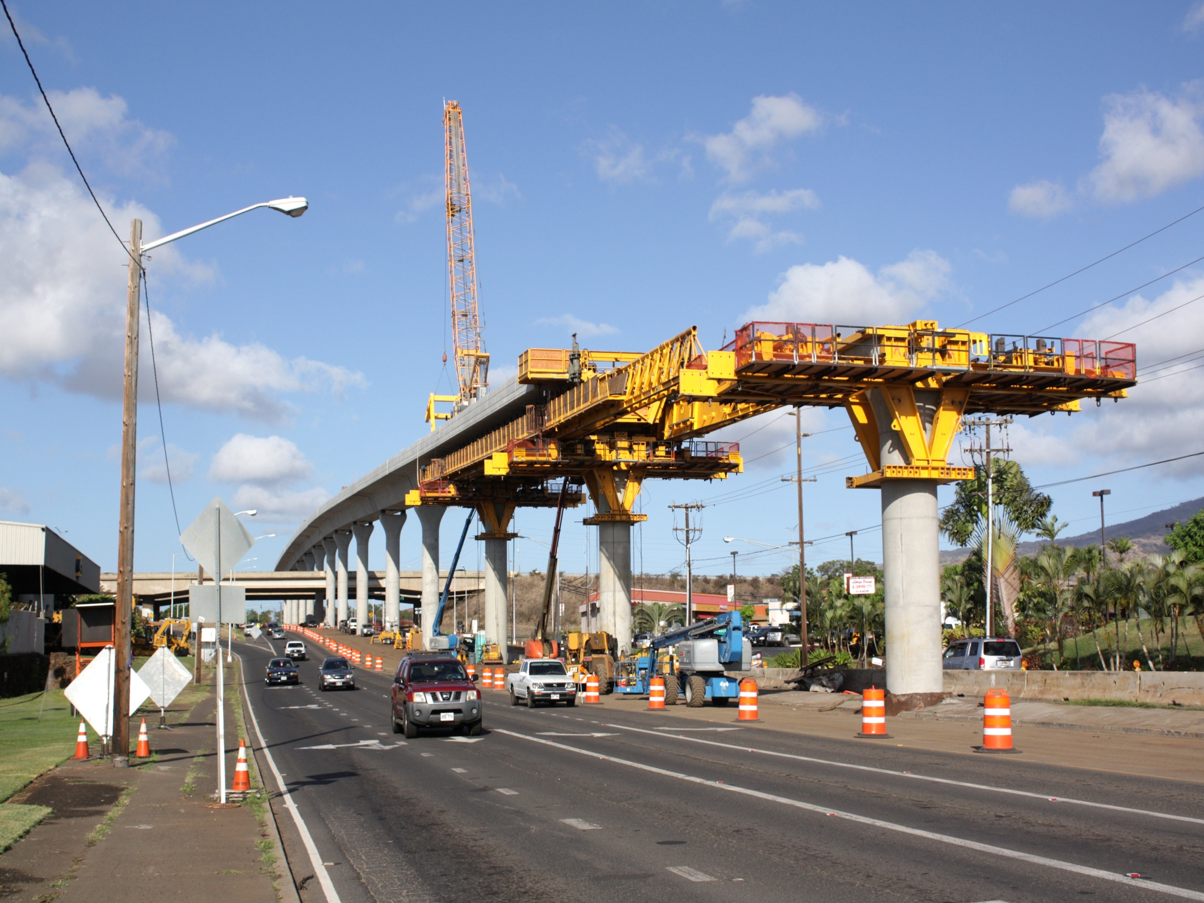
#3 Transient Future Homeless Population
Notes:
Simply, in a future market, we will have a more transient homeless population. Currently, clients travel within a mile or two radius. But with more public transportation, more movement will occur.
We need the community to be our referral system.

Slide 8
WHAT IS A MOBILE OUTREACH TOOL?

Slide 9
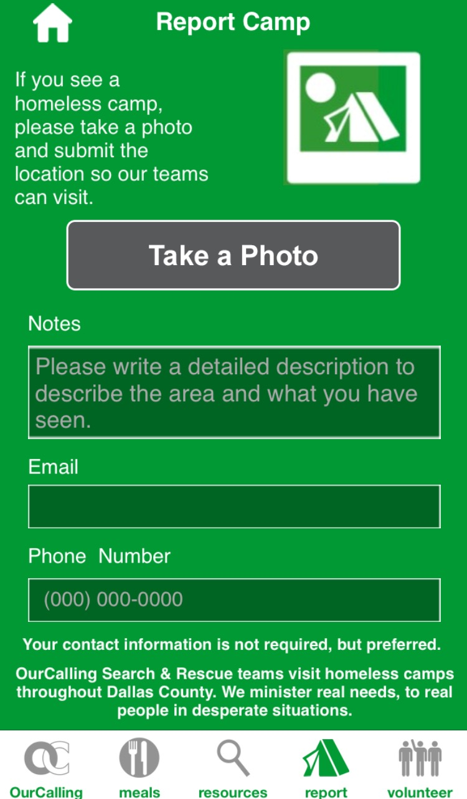
Our Calling Homeless Response App & Outreach is located in Dallas, Texas.
Mobile App Code is not available for duplication or customization
Closed Source Fields:
Photos of Encampments or Individuals
(Native App)
Descriptive information
How to contact the referencing party
Note: Directory of Services (Open Source Fields)
Notes:
Our Calling is a homeless outreach provider located in Dallas Texas. They are not willing to share their code despite me asking 2-years ago.
To abide by HIPPA and Public Information laws, we would need to keep certain information private from the general public – photos, contact information, identity of homeless individuals.
Note: Scott Morishige up next to discuss Directory

Slide 10
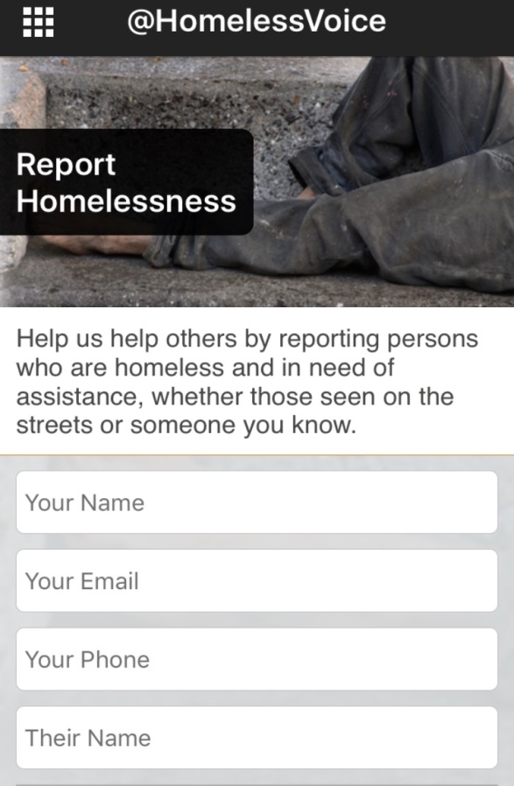
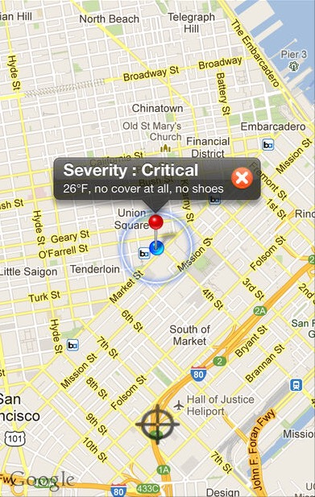
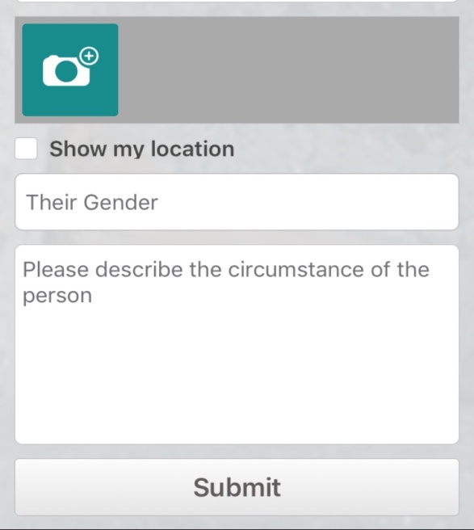
Location Sharing – Open Source Fields:
Geo-Coordinates by Longitude and Latitude – Google Maps Style
Pin Drops by District or Area – Keep it general, but keep options open to design and create custom maps
Factor Inside vs. Outside Buildings
Sharing location
Notes:
At the same time, we want the public to be motivated to pin drop and share geo-coordinates that provide insight to locations of homeless encampments and individuals needing help.

Slide 11
HOW WILL THE MOBILE OUTREACH TOOL BE USED?

Slide 12
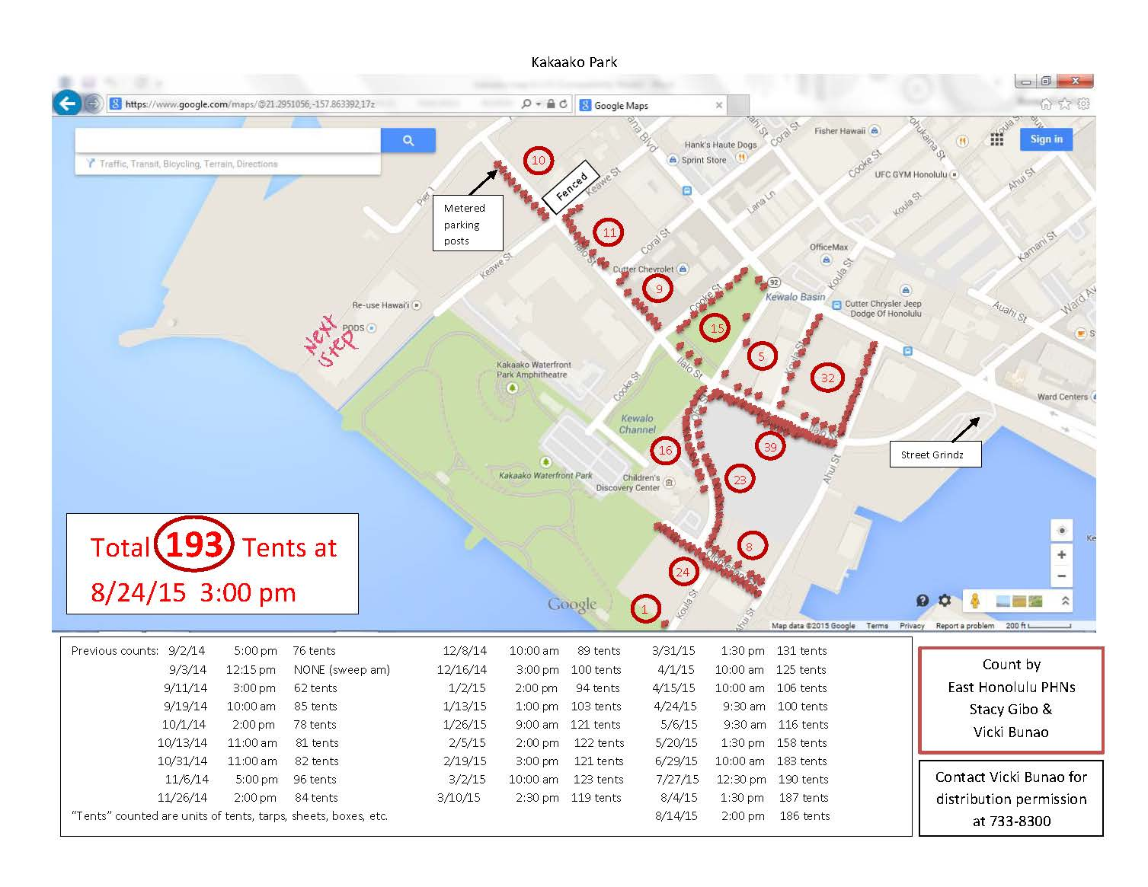
Information Received into Database & accessed by Outreach Providers
Secure Web Interface
App Connects to API
Homeless Outreach Response
Notes:
Data collected would be used to respond. Public Health Nurses used GPS to plot the location of each tent in Kakaako one year ago. This information was extremely valuable to service providers responding. Benefits included:
Planning efficiently what resources were needed to outreach and respond,
Knowing how many shelter beds were needing to be made available throughout Oahu,
Knowing the types and amount of services, housing assistance programs and resources that were needed to respond
Having a by-name list in order to track new individuals and families falling into homelessness vs. moving out of homelessness

Slide 13
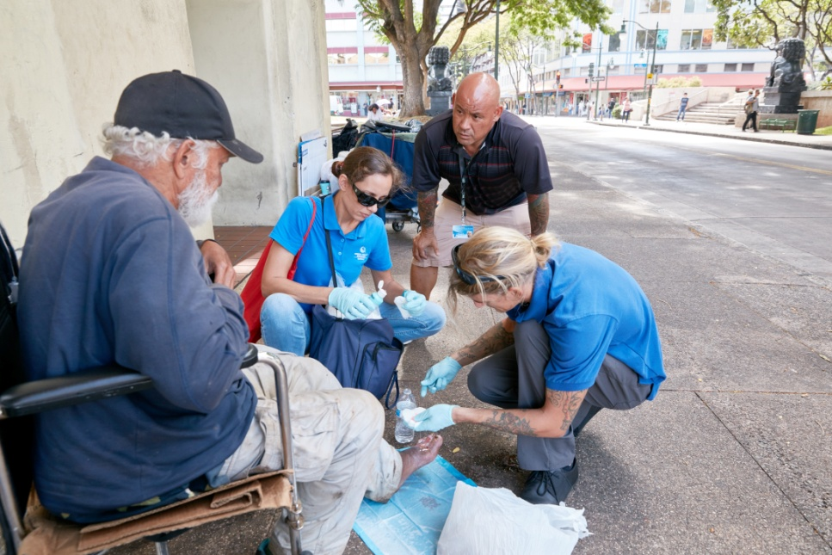
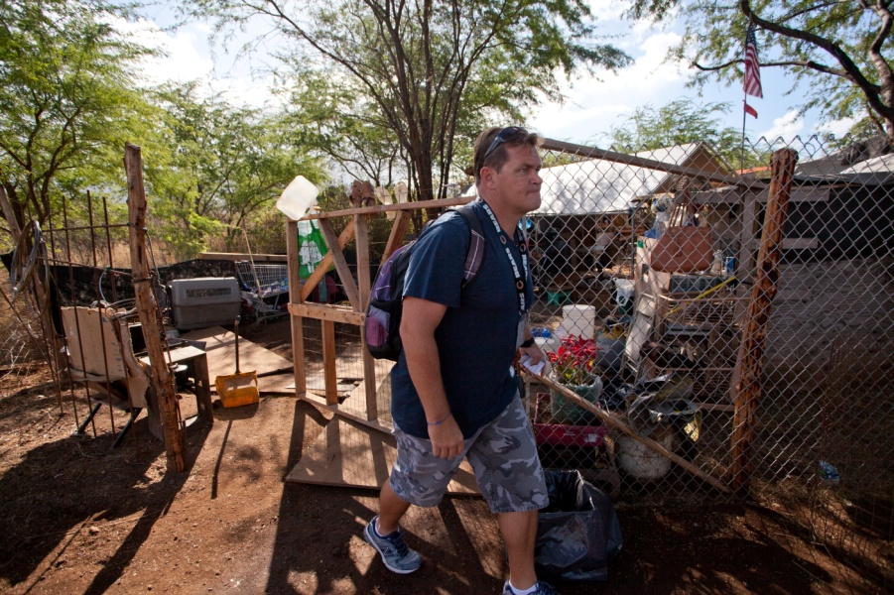
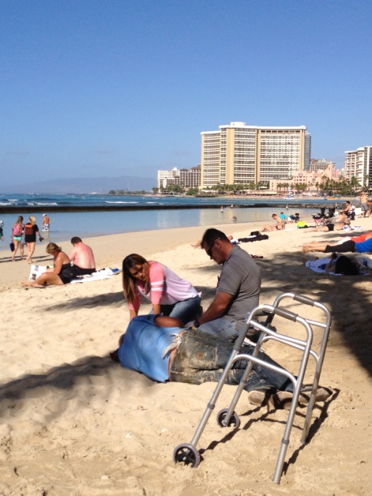

Notes:
Field Outreach Teams across Oahu Respond to these inquiries

Slide 14

Coordinated Response & Entry Into Services
Mobile App Users
Hospitals & Medical Centers
Businesses
Assessment & Triage
AUW 211
Service Providers
Direct Emails
Phone Calls

Slide 15
Case Management
Homeless Outreach
General Public
Housing Support
Emergency Shelter
& Triage
Education
Shelter (CM & Staff)
Transients
Veterans
Homeless Providers
Inmates
Coordinated Entry, Assessment & Triage
Vulnerable
Non-Chronic
Youth
Legal Assistance
Families with
Children
In-Crisis & At-Risk
(Newly Homeless)
Veterans Services
Chronic Homeless
-Mentally Ill
-Substance Abuse
Healthcare
Psychiatric Care
Substance Abuse Treatment
Employment Support

Slide 16
THE CHALLENGE
HELP Homeless Outreach Teams Efficiently Respond to Community Referrals Through Use of Mobile Apps

Slide 17
THE CHALLENGE
BE PART OF THE SOLUTION

Slide 18

MAHALO!

